Slide 1


Slide 2


Slide 3


Slide 5
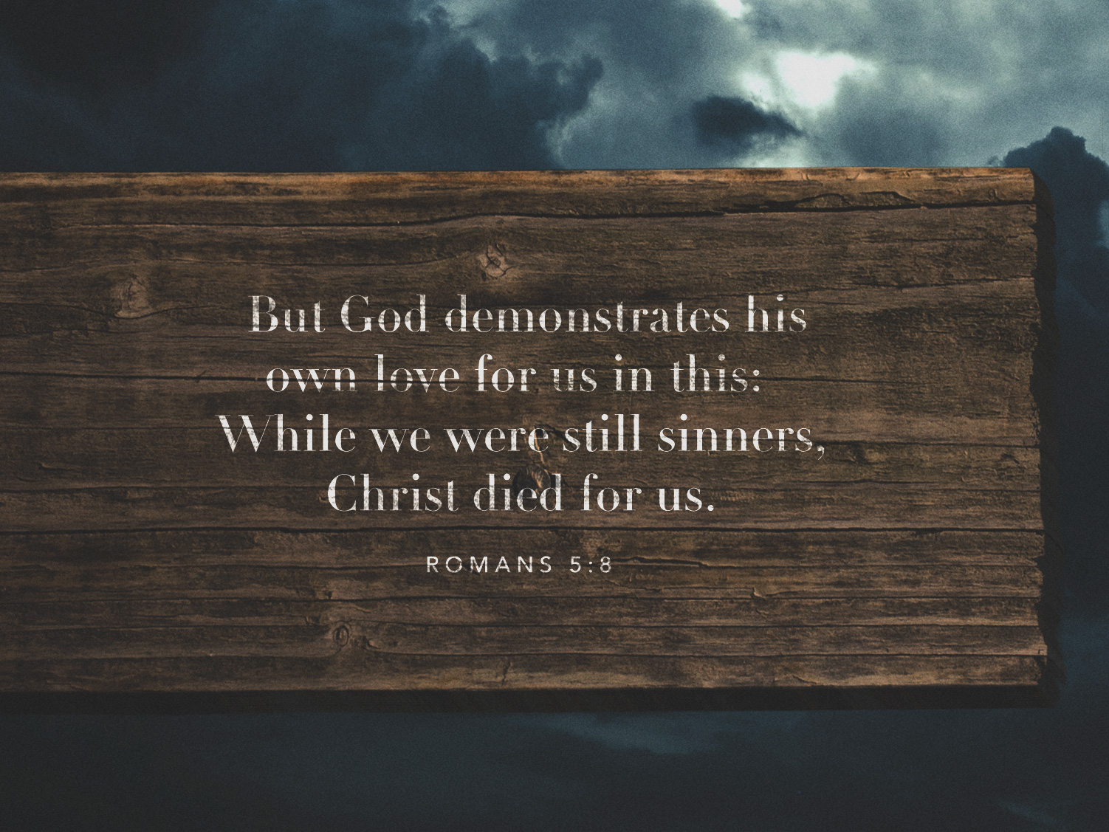

Slide 6
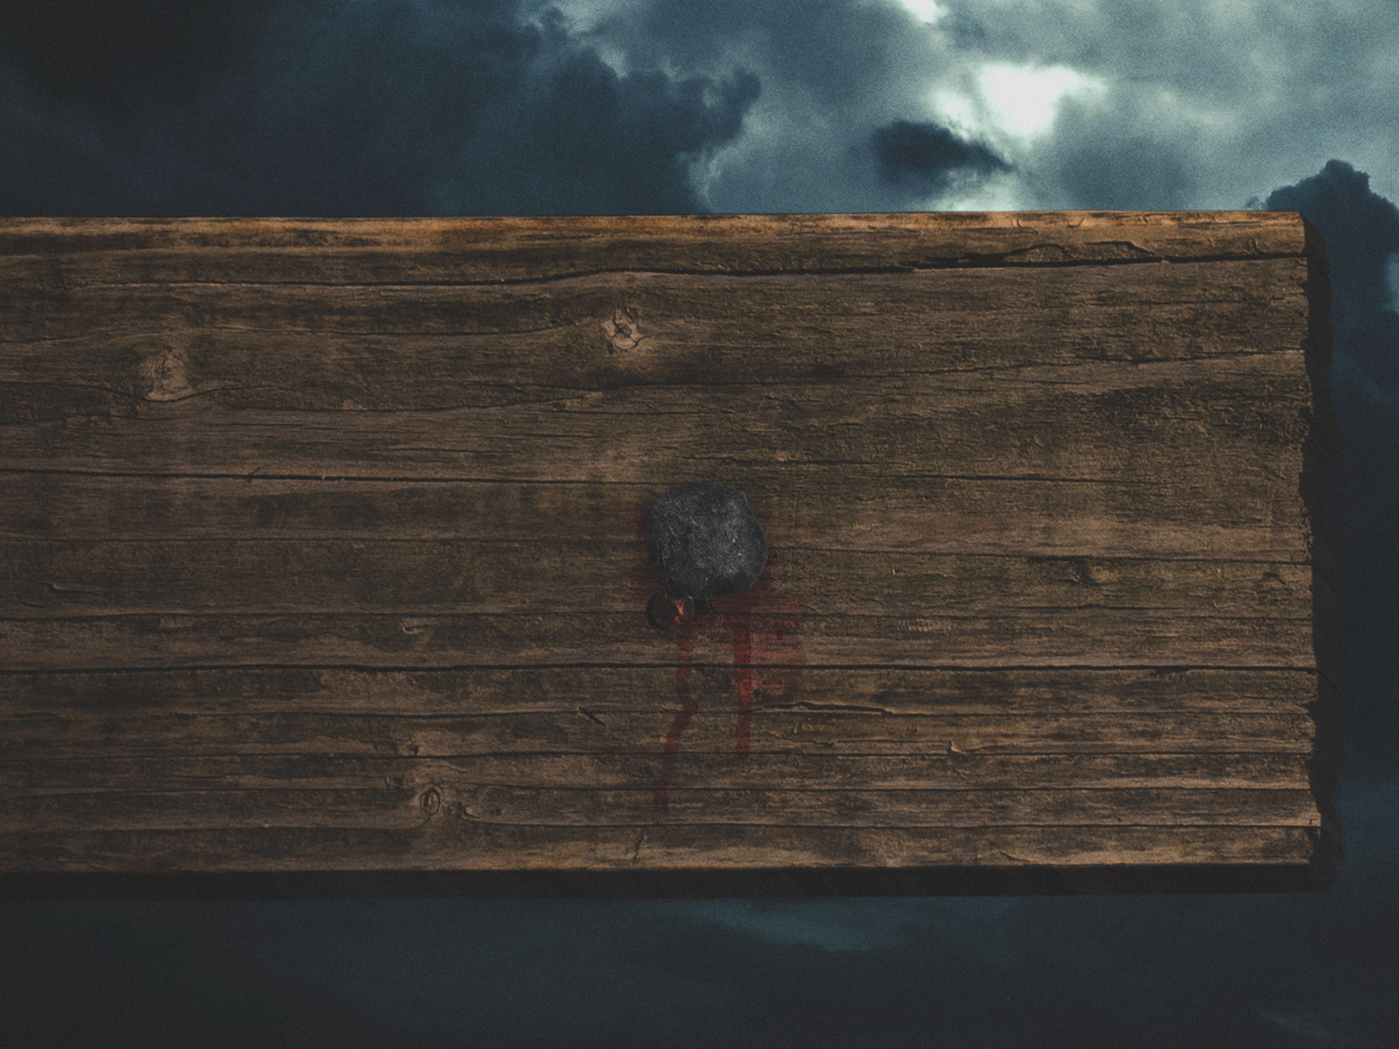

Slide 7
1. We are helplessly lost without Christ
Powerless
UnGodly

Slide 8
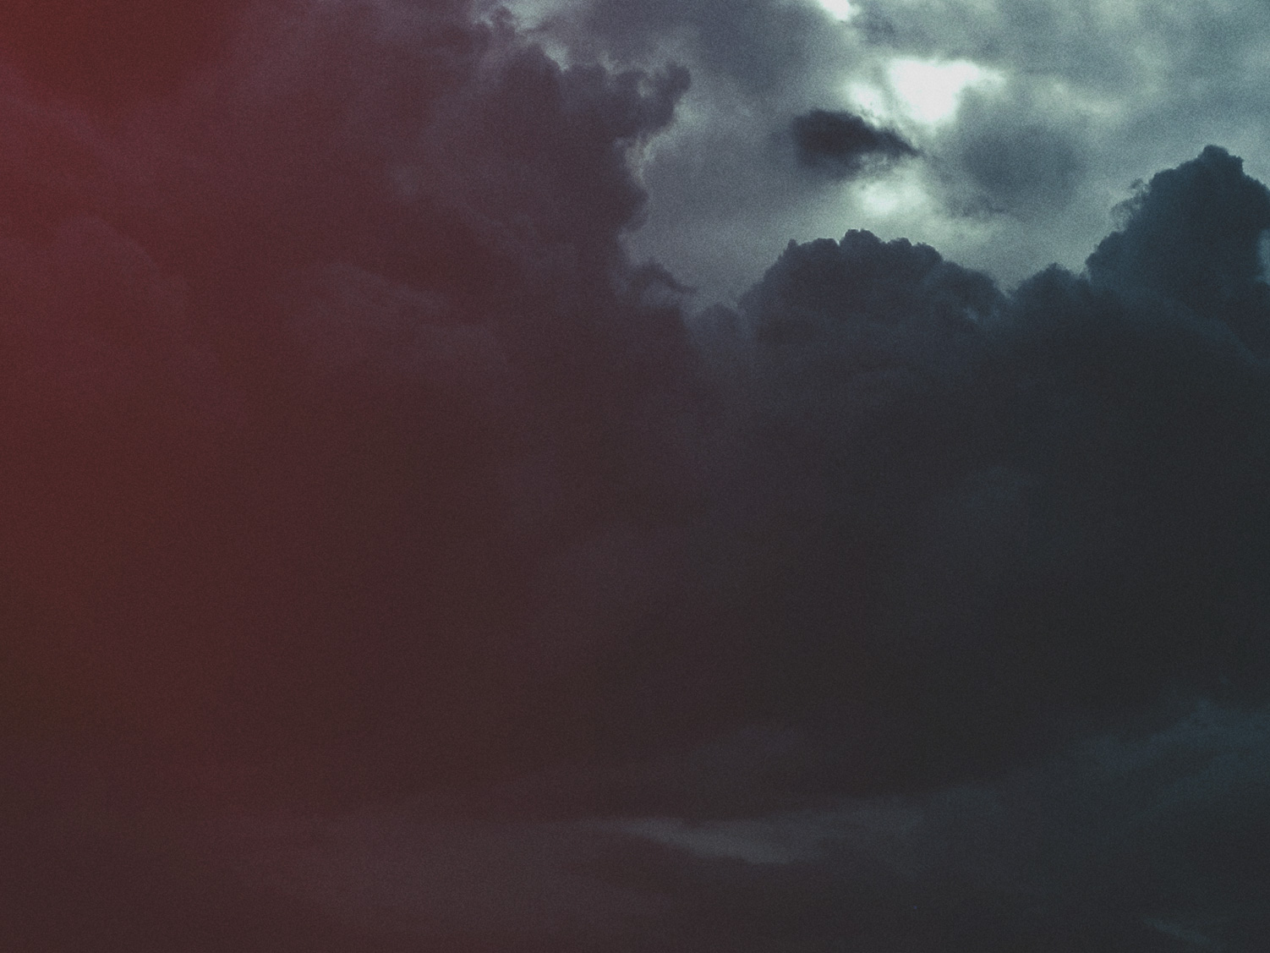
2. God's demonstration of Love
Not just heroic actions...
Sacrificial Love...

Slide 9
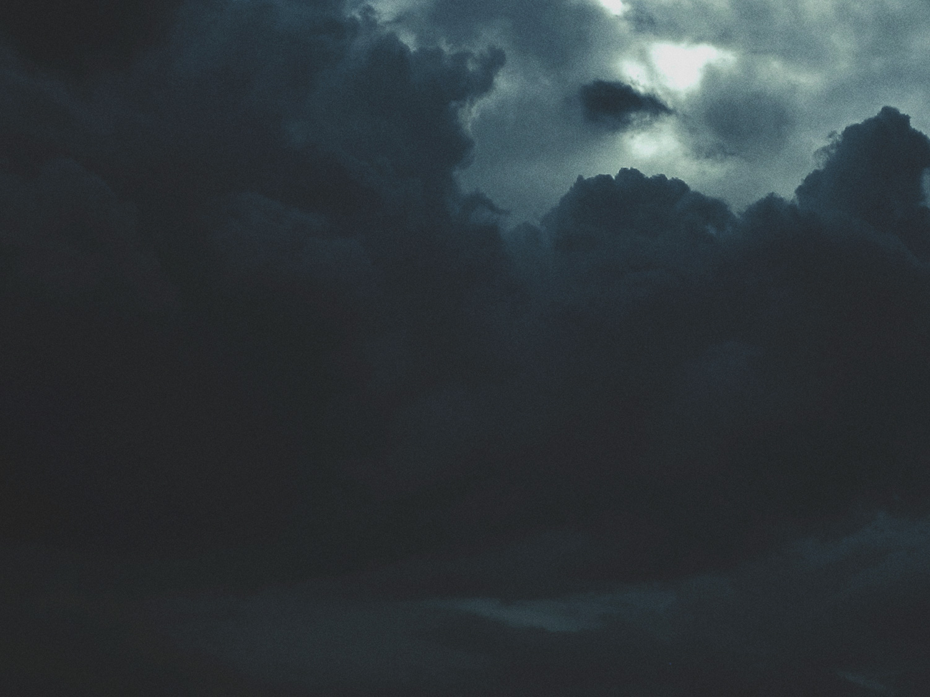
3. Reconciled to God
Justified by his blood
Saved from wrath

Slide 10


