Slide 1
#My Temporary Grave
1 Thessalonians 4:13-18

Slide 2
1. The Hope of Resurrection
Christ will wake up the sleeper!

Slide 3
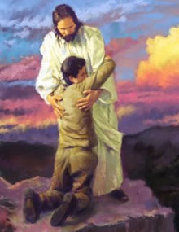
2. Going to Heaven
While the body rests the soul is with God!

Slide 4
3. The Rapture
God will reunite the Body and Soul!

Slide 5
4. Encourage one another with this!
# Share this!

