Slide 1
NOOBS, AMATURES, and TOTS
Work of Faith, Labor of Love, Endurance of Hope
1 Thessalonians 1:3

Slide 2
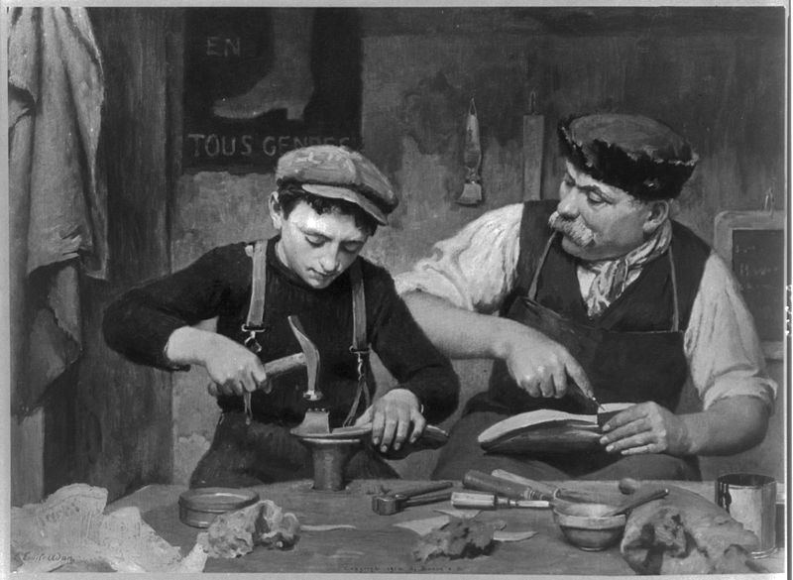
Work of Faith
Apprenticeships
Discipleship
Alongsiders
Work produced by Faith

Slide 3
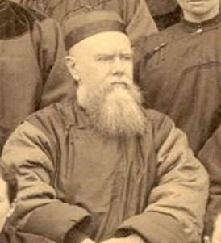
Labor of Love
Amateur
Ground breakers
“You must go forward
on Your knees” --- Hudson Taylor

Slide 4
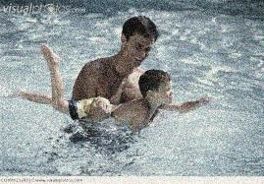
Patience of Hope
Postman-like tenacity
The Hope Factor – God is Watching
Perspective 1: God is evaluating
Perspective 2: God is looking after

