Slide 1
How big is your Basket?
Thoughts from the book of Matthew

Slide 2
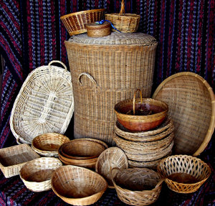
Matthew 14-15 (15:37)

Slide 3
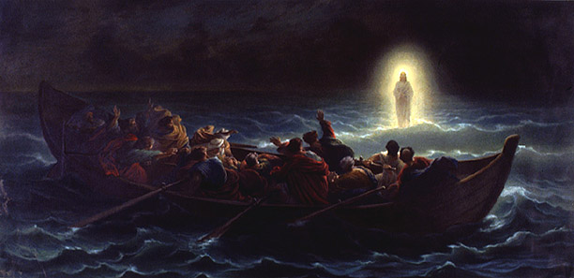
Matthew 14:22-36

Slide 4
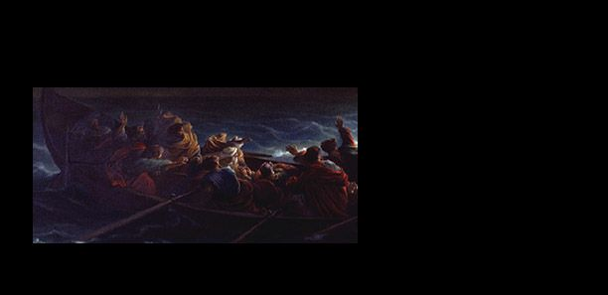
Isolation from Jesus leads to Fear
Take courage! It is I. Don’t be afraid. V.27

Slide 5
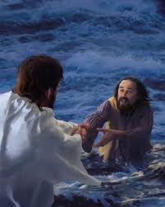
Take a Risk

Slide 6
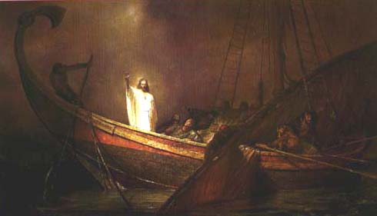
They worshiped Jesus

Slide 7
How big is your Basket?
Thoughts from the book of Matthew

