Slide 1
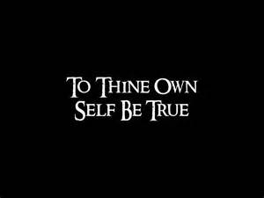
be true
1 Corinthians 4:1-13

Slide 2
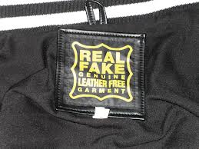
Genuine real imitation vv.1-5
…you ought to regard us: as servants of Christ and as those entrusted with the mysteries God…
¹⁶ Therefore I urge you to imitate me.
1 Cor . 11:1 Follow my example, as I follow the example of Christ.
Servants
Entrusted
Real people
guilty but not ashamed!

Slide 3
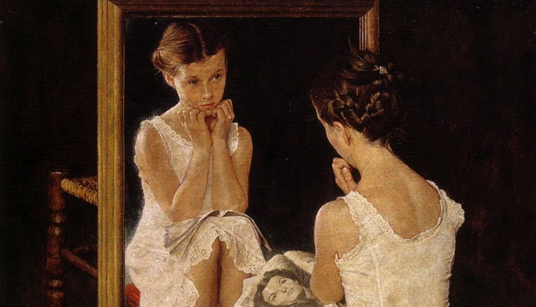
Accepting God’s design vv.6-7
“Do not go beyond what is written.”
What do you have that you did not receive?

Slide 4
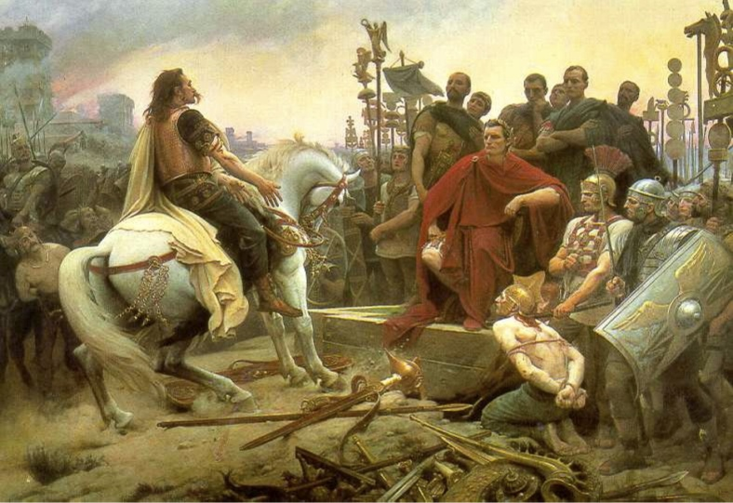
Captured Kings vv.8-13 Not Carnival Queens
“God has put us apostles on display at the end of the procession, like those condemned to die in the arena.”
“ We have become the scum of the earth, the garbage of the world—right up to this moment.”
“"Better to reign in Hell, than serve in Heav'n” attributed to Satan John Milton, Paradise Lost

