Slide 1
Be true part 2
1Cor 4:6-7

Slide 2
Get Real
1 cor 4:6
1. It’s about you. I have been using Myself and Apollos as the subjects of this lesson but in reality you are the real subjects of it.

Slide 3
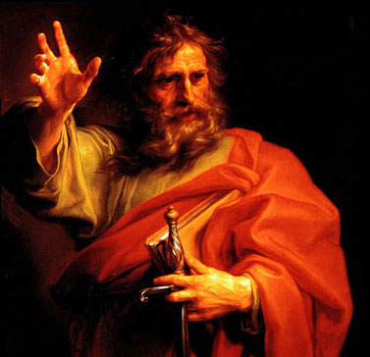
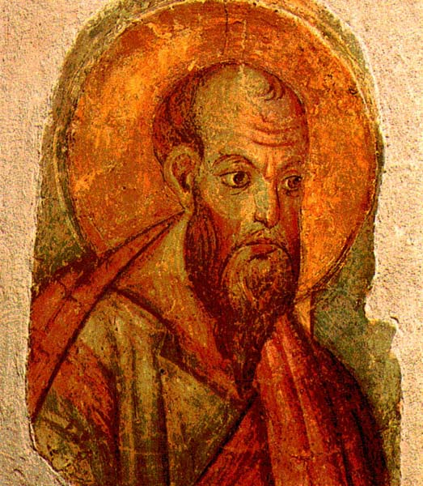
Real people
2. You should not think of anyone based on overly embellished exploits or exaggerated tales. Don't go beyond what is written. Instead stick to the real record.
a. What does your private and public record say?
b. What does the Bible say about us?
c. What does Jesus say?

Slide 4
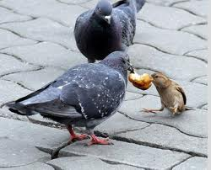
Really?
By doing so no one should get conceited and puffed up. No should compare one person to another.

Slide 5
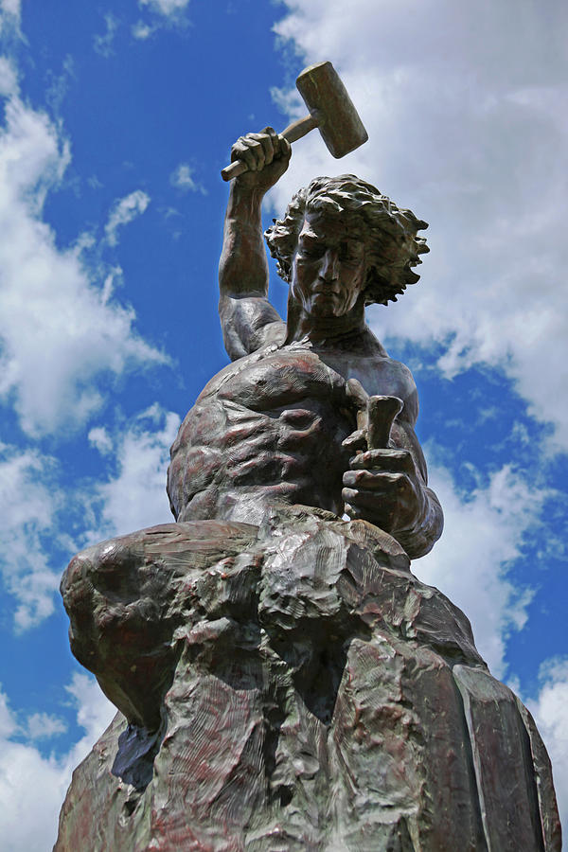
Self-made or God Made
7. Who has made you different from others. And what qualities, gifts, and talents, do you have that were not given to you? Why do you exalt your own abilities as though you came by them on your on, as if they were not given to you by God.

