Slide 1
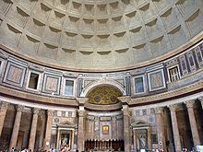
Grace to Build
1 Corinthians 3:9-15

Slide 2

Built Through Grace
Grace comes before excellence…
^{1Co 3:10} By the grace God has given me, I laid a foundation as an expert builder, and someone else is building on it. But each one should be careful how he builds.

Slide 3
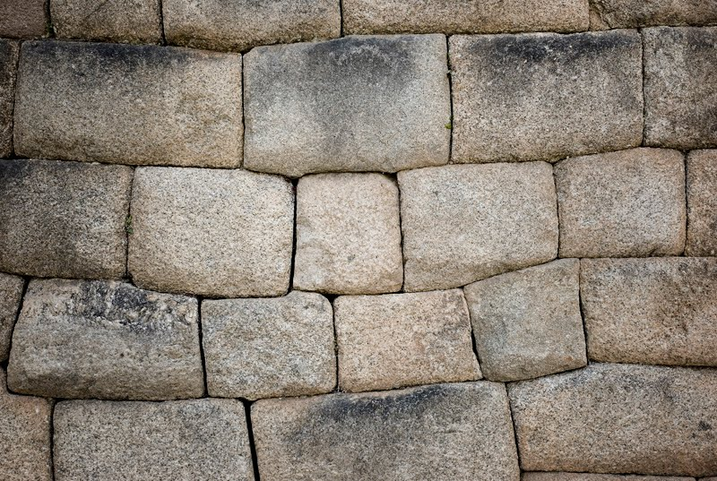
Built on Christ
One Eternal Foundation
^{1Co 3:11} For no one can lay any foundation other than the one already laid, which is Jesus Christ.

Slide 4
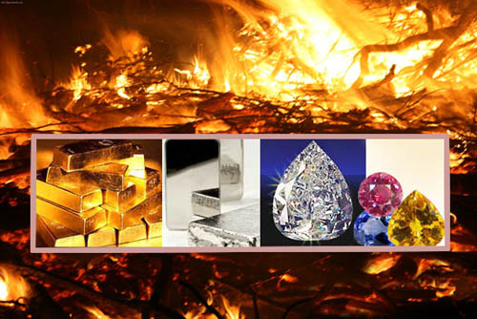
Built to Last
The Stuff of Heaven or the Stuff of Earth
^{1Co 3:12} If any man builds on this foundation using gold, silver, costly stones, wood, hay or straw, ¹³ his work will be shown for what it is…

